Slide 1
Web programming
Body
Heading
Physical
Horizontal Rule
Marquee
Table
Form
Image Map
Anchor
List
Frameset
Iframe
HTML+DHTML+PHP

Slide 2
HTML
DAY : 1
Learning Objectives:
to understand about the usage of Web Pages
to describe the Basic structure of HTML tags.
to List down the Attributes of Body Tag

Slide 3
Basic Structure of HTML
<HTML>
<HEAD>
<TITLE>
…….
</TITLE>
</HEAD>
<BODY>
---------------
</BODY>
</HTML>

Slide 4
Attributes of body tag ex, <BODY bgcolor=“red”>
BGCOLOR=”color”
TEXT=”COLOR”
LINK=color
VLINK=color
ALINK=color
BACKGROUND=”path”
RIGHTMARGIN=pixels
BOTTOMMARGIN=pixels
Home

Slide 5
Example
Program Wep page

Slide 6
SAMPLE OUTPUTS

Slide 7
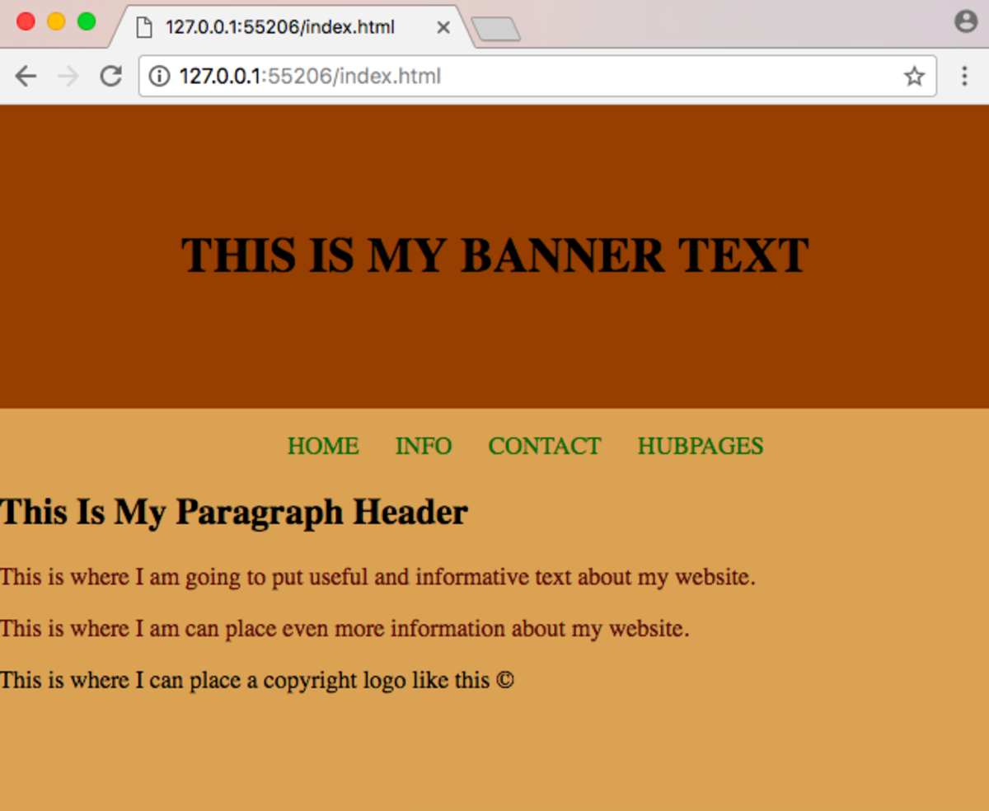

Slide 8


Slide 9


Slide 10
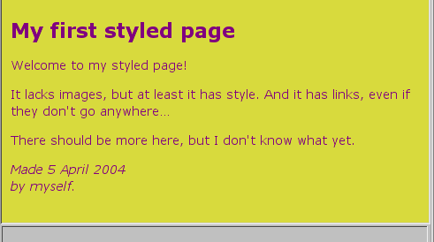

Slide 11
Heading TAGS
DAY : 2
Learning Objectives
To identify the purpose of Heading tags,paragraph tag,break tag..
Differentiate the usage of paragraph and Break tag
To set image in the background of body area

Slide 12
Types of Heading TAGS
Heading styles
Tags
<h1>..</h1>
<h2>…</h2>
<h3>…</h3>
<h4>….</h4>
<h5>…</h5>
<h6>…</h6>
Attributes
Align=”left/right/center”
Home

Slide 13
Paragraph:
Tag Attribute
<p> Align=”left/right/center”
Break
Tag Attribute
<br> Clear=”left/right/all”
Image
Tag Attributes
<img>……...</img> <img Src=”URL”>
Align=”left/right,centertop/middle/bottom”
Height=53
Width=40
Hspace=value
Vspace=value
Pre-formatted Text
Tag
<pre>……</pre>

Slide 14
Horizontal Rule
Tag: <HR color=“red”>
Attribute
Align=”left/right/center”
Size=”value”
Width=”value/percent”
Noshade
Color=”#hexvalue/color”
Home

Slide 15
EXAMPLE-2
Program Webpage

Slide 16
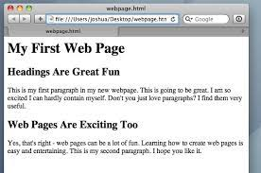
Sample Outputs

Slide 17
Enhancing styles
Day : 3
Learning Objectives:
To understand the usages of styles
To implement the physical and logical styles in HTML codes
To create the web page with special pattern.

Slide 18
Physical styles
<B>.. </B>
<I>…</I>
<U>…</U>
<TT>…</TT>
<BIG>……</BIG>
<small>….</small>
<center>….</center>
Home

Slide 19
Logical styles
<EM>….</EM>
<STRONG> …. </strong>
<DFN>…</DFN>
<CODE>….</CODE>
<KBD>…<KBD>
<DEL>…</del>
<INS>……</ins>
<person>…<person>
<var>…</var>
<acronym>…</acronym>
<abbrev>…….</abbrev>
<cite>………</cite>

Slide 20
Marquee
Tag Attributes
<marquee>……</marquee> Width=”pixels/percentage”
Height=”pixels/percentage”
HSpace=”pixels”
vSpace=”pixels”
Align=”top/middle/bottom”
Behavior=”scroll/slide/alternate”
Direction=”left/right”
Loop=”number/infinite”
Scrollamount=”pixels”
Scrolldelay=”milliseconds”
Bgcolor=”#RRGGBB/colorname”
Home

Slide 21
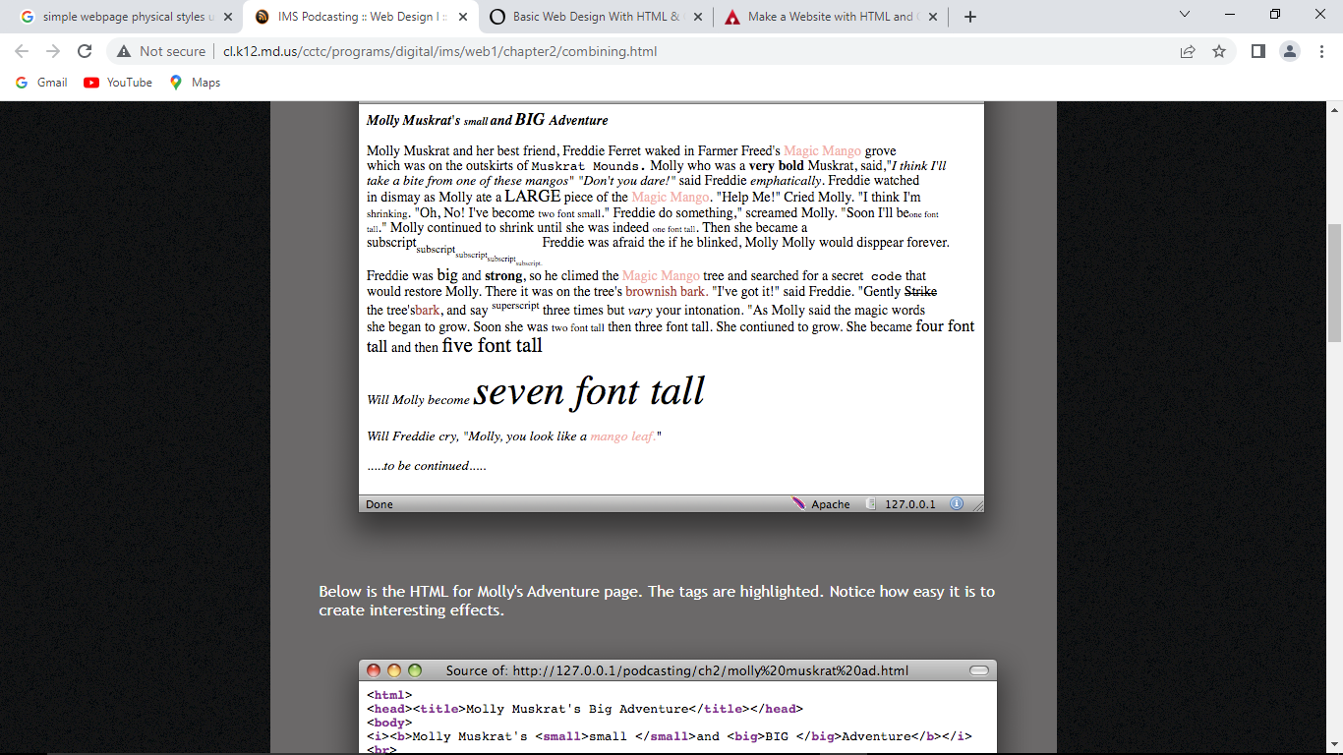

Slide 22

Sample output : Marquee

Slide 23
List Tag: <li>….</li>
Types
Ordered List <OL>…..</OL>
Unordered List <UL> -- -- ---</UL>
Definition Language <DL> . .</DL>
Home

Slide 24
Ordered List
Tag:
<ol>….</ol>
Example:
<ol type=“A”>
<li>…………..
<li>…………….
<li>……………
</ol>
Attribute:
Type=”I/A/a/i/1”
Start=number/letter

Slide 25
Unordered List
Tag: <UL> -- -- ---</UL>
Attribute:
Type=”disc/circle/square”
Example:
<ul type=“square”>
<li>…………..
<li>…………….
<li>……………
</ul>

Slide 26
Definition Language
Tag
<DL>….</DL>
Sub Tag
<DT>…</<DT>(Definition Term)
<DD>….</DD>(Data Definition)
Example:
<DL>
<DT>……..</DT>
<DD>…………….</DD>
</DL>

Slide 27
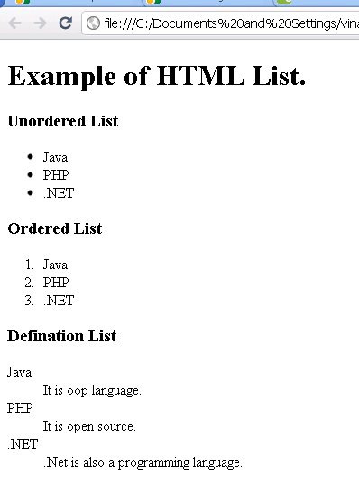

Slide 28
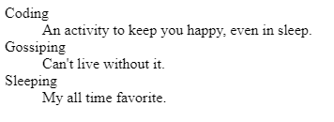
Output: Definition Language

Slide 29
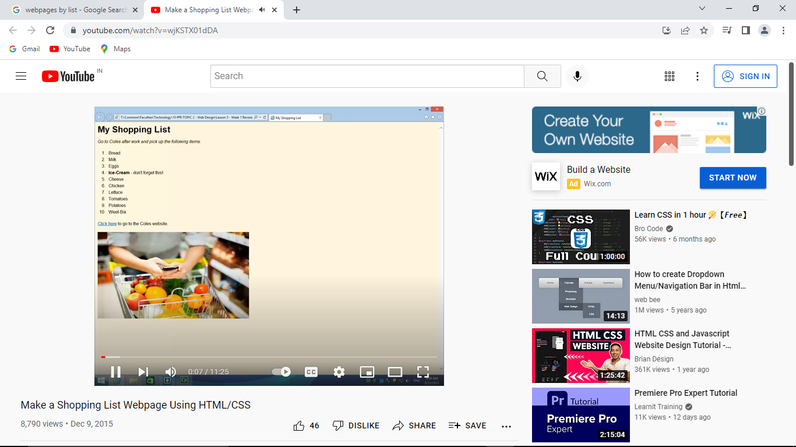

Slide 30
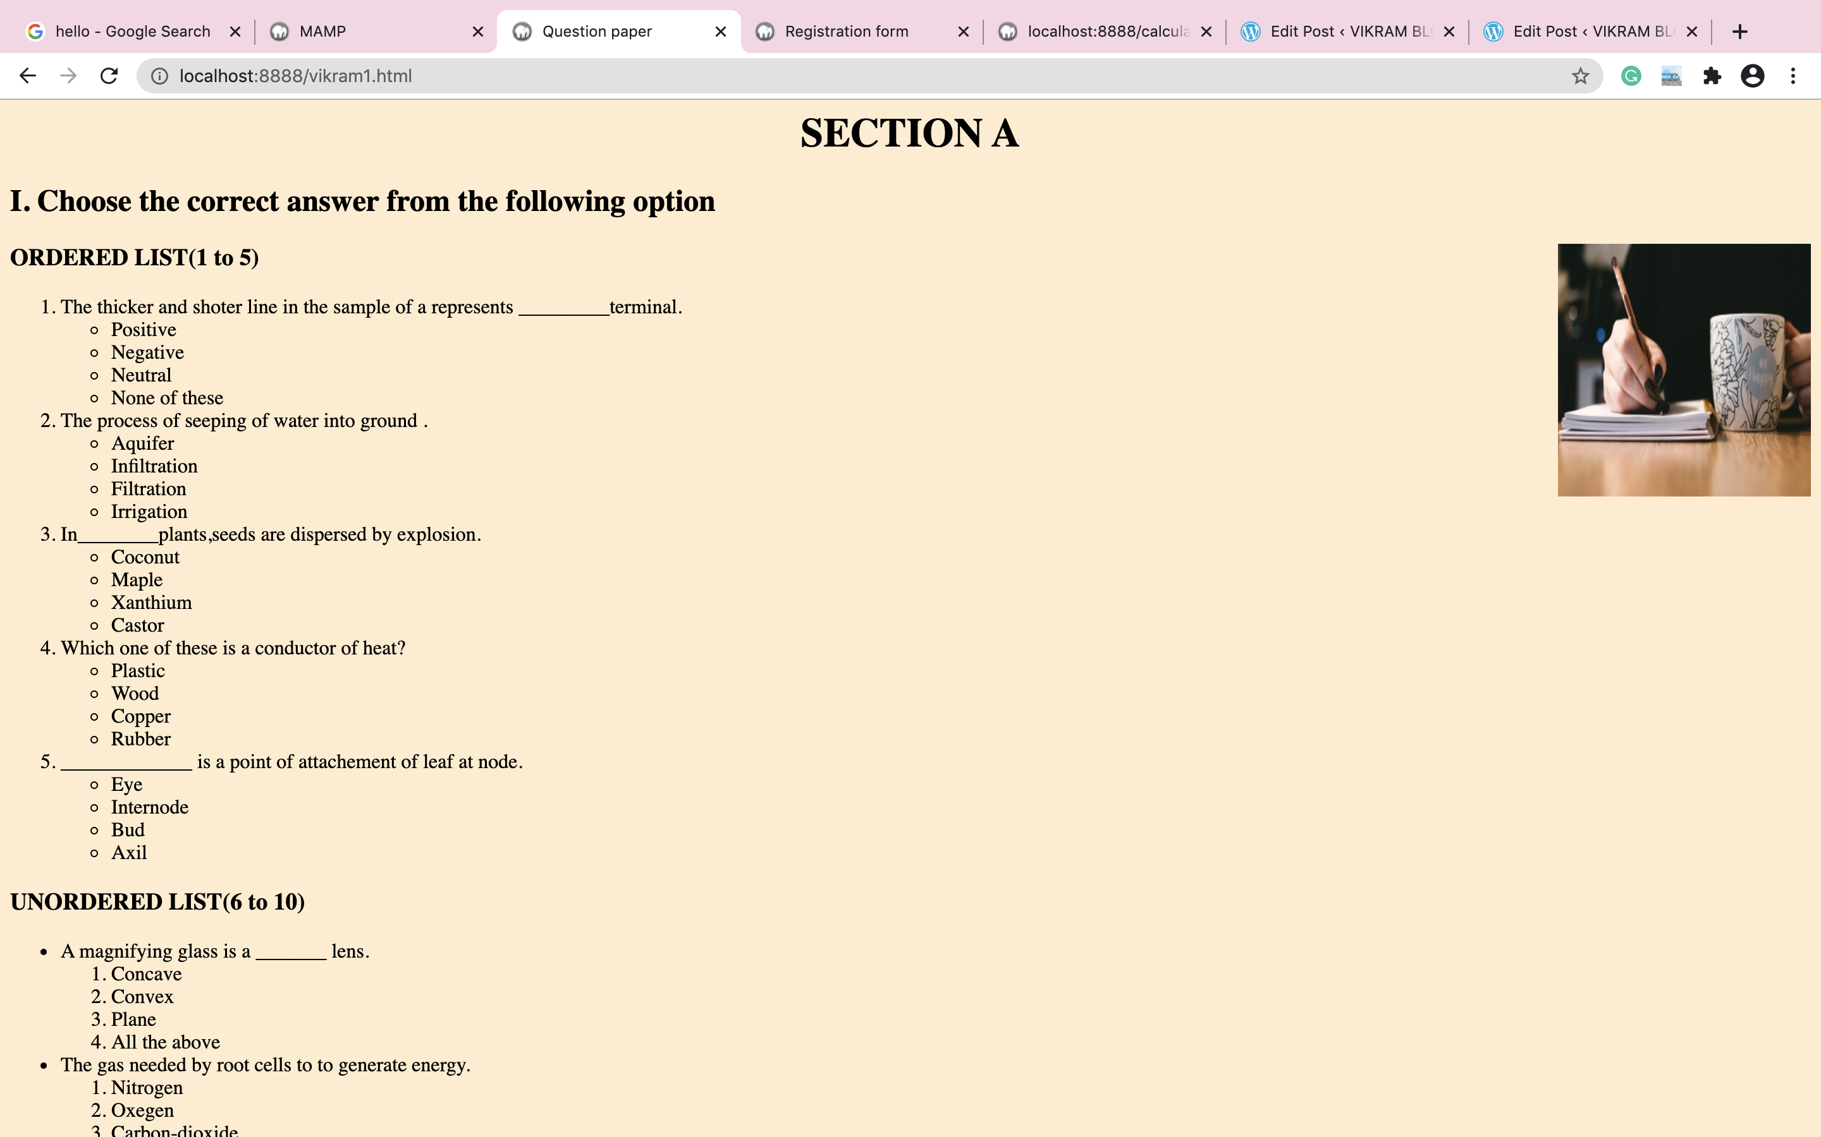

Slide 31
Anchor tag:
<A>…………….</A>
Attributes:
href=”url”
Name=”text”
Title=”text”
Target=frame name/window name
Home

Slide 32
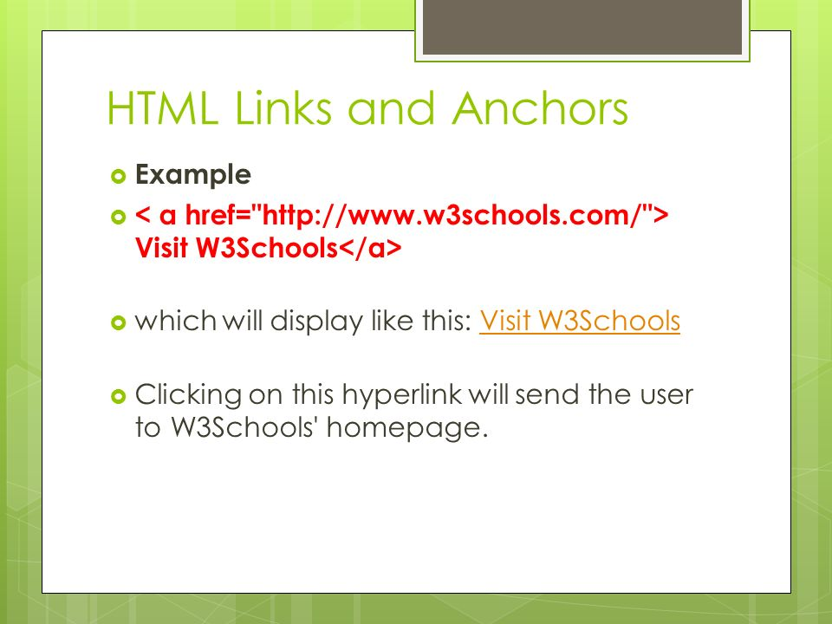

Slide 33
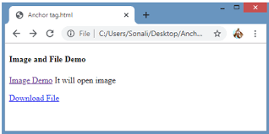

Slide 34
image map
rect - defines a rectangular region
circle - defines a circular region
poly - defines a polygonal region
default - defines the entire region
The <map> tag is used to define an image map.
An image map is an image with clickable areas.

Slide 35
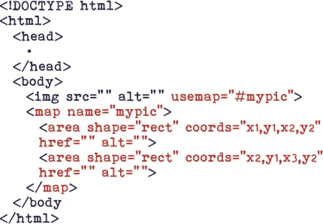
Syntax

Slide 36
Example
<img src="https://iso.500px.com/wp-content/uploads/2016/03/stock-photo-142984111-1500x1000.jpg" border=10 alt="not found" usemap="#nature">
<map name="nature">
<area shape="rect" coords="0,0,150,250" href="tab.html">
</map>

Slide 37
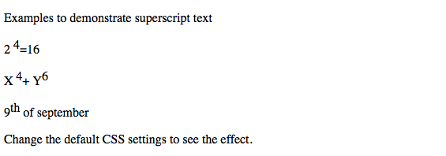

Slide 38
Comments:
Two types
1. <!-- - ->
2. <comment>…….</comment>

Slide 39
Superscript tag
<sup>…</sup>
Subscript tag
<sub>…</sub>
Extended Quotation
Character code
& &amp
> &gt
< &lt
® &reg
© &copy

Slide 40
Table
Tags: <Table>,<caption>,<TR>,<TH>,<TD>
1.<Table> : Attributes
Border=value
Align=left/right
Cellspacing==value
Cellpadding=value
Width=value/percent
Bgcolor=colorname
Background=”path”
Bordercolor=”colorname”
Bordercolordark=”color”
Bordercolorlight=”color”
Home

Slide 41
2.<TR> or <TD> or <TH>
Attributes
Align=”left/right/center/top/middle/bottom”
3.<TD>or <TH>
Attributes
Width=value/”percent”
Height=value/”percent”
Nowrap
4.<TH>
Attributes:
ROWSPAN=value
COLSPAN=value

Slide 42
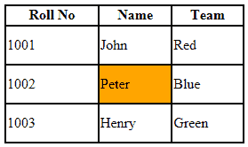
Sample : Table

Slide 43
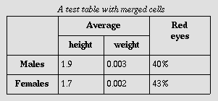

Slide 44
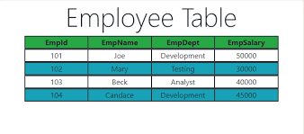
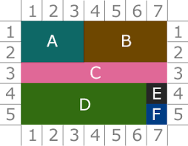

Slide 45


Slide 46
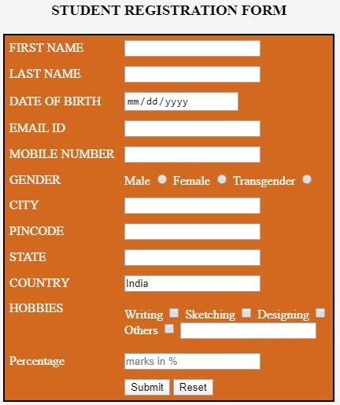
FORM
Home

Slide 47
<form>
<input type=“text” name=“name”value=“username”>
-----------
----------------
-----------
</form>
Tags
<FORM>
<INPUT>
<TEXTAREA>
<SELECT>
<OPTION>

Slide 48


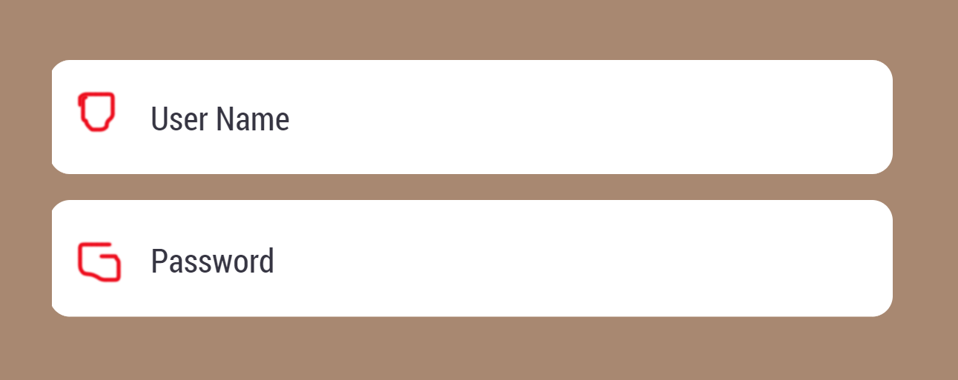
Dialog items
Check box
Radio button
Text entry
Password
Image
File
Submit
Reset
Hidden
Drop down list
Select box
Text area

Slide 49
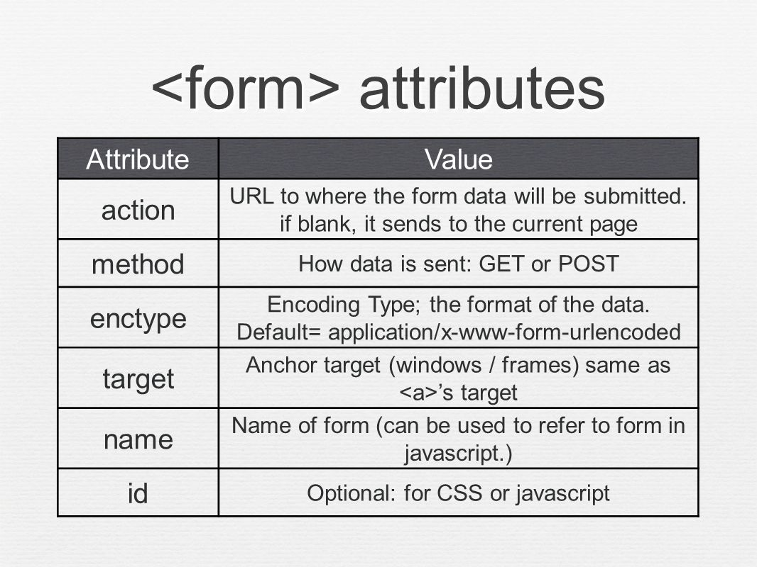
<Form> Attributes

Slide 50
<input>
<input type="button">
<input type="checkbox">
<input type="color">
<input type="date">
<input type="datetime-local">
<input type="email">
<input type="file">
<input type="hidden">
<input type="image">
Ex,
<form>
<input type=“date”>
-----------
----------------
-----------
</form>

Slide 51
<input type="number">
<input type="password">
<input type="radio">
<input type="reset">
<input type="search">
<input type="submit">
<input type="text"> (default value)
<input type="time">
<input type="url">
Eg,
<input type="text">, <input type="checkbox">, <input type="radio">, <input type="file">, and <input type="password">.

Slide 52
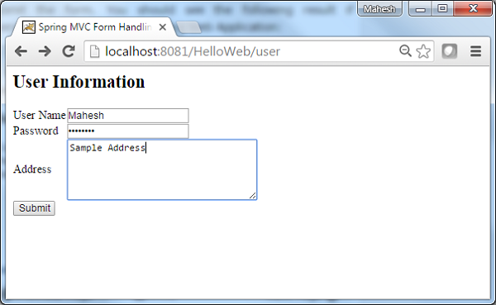

Slide 53
text
<input type="text">
Type=“text”
Name=“Text”
Size=value
Maxvalue=value
Value=“Text”

Slide 54
password
<input type="password">
Type=“password”
Name=“text”
Size=value
Value=“text”

Slide 55
Sample output
Webpage

Slide 56
<input type="image">
Type=“image”
Src=“url”
Align=“left/right/top/bottom/middle
Border=pixels
Height=pixels
Width=pixel
Hspace=pixels
Vspace=pixels
Home

Slide 57
<textarea> Tag
Attributes
cols | number | Specifies the visible width of a text area
maxlength | number | Specifies the maximum number of characters allowed in the text area
name | text | Specifies a name for a text area
placeholder | text | Specifies a short hint that describes the expected value of a text area
required | required | Specifies that a text area is required/must be filled out
rows | number | Specifies the visible number of lines in a text area
wrap | hardsoft

Slide 58
Example:
<textarea id="w3review" name="w3review" rows="4" cols="50"> At w3schools.com you will learn how to make a website. They offer free tutorials in all web development technologies. </textarea>

Slide 59
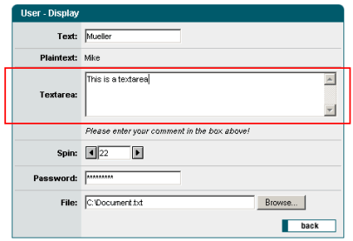

Slide 60
File
<input type="file">
Type=“file”
Name=“text”
Size=value
Maxlength=value

Slide 61
Button
<input type="button">
Type=“button”
Name=“text”
Value=“text”

Slide 62
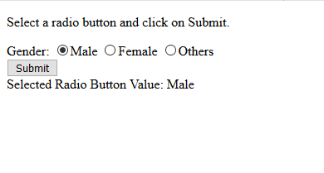
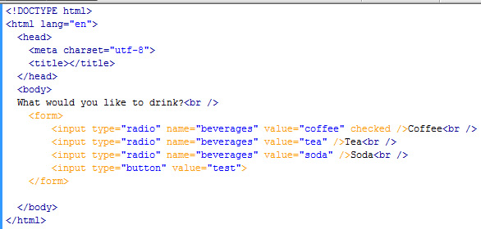
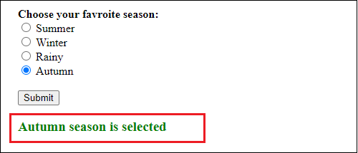
<input type="radio">
Type=“text”
Name=“text”
value=“text”
checked

Slide 63
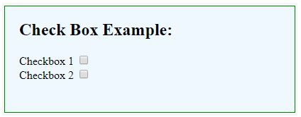
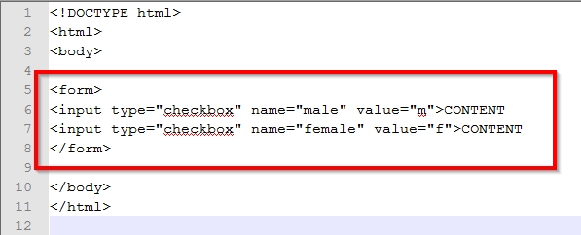
<input type="checkbox">
Type=“checkbox”
Name=“text”
Value=“text”
checked

Slide 64
<select> Tag
Definition and Usage
<select> element is used to create a drop-down list.
most often used in a form, to collect user input.
name attribute is needed to reference the form data after the form is submitted (if you omit the name attribute, no data from the drop-down list will be submitted).
id attribute is needed to associate the drop-down list with a label.
<option> tags inside the <select> element define the available options in the drop-down list.
Attributes
<select>
name
id
option

Slide 65
submit/reset
<input type="submit“/”reset”>
Type=“submit”/”reset”
Value=“text”

Slide 66
Hidden
<input type="hidden">
Type=“hidden”
Name=“text”
Value=“text”

Slide 67
<select> <option>
Attributes <option>
value=“text”
selected
Attributes <select>
Name=“text>
Size=value
multiple
Example:
!-- The second value will be selected initially -->
<select name="choice">
<option value="first">First Value</option>
<option value="second" selected>SecondValue</option> <option value="third">Third Value</option>
</select>

Slide 68
Sample web page
Home

Slide 69
Create Sample forms for oline Voting System

Slide 70
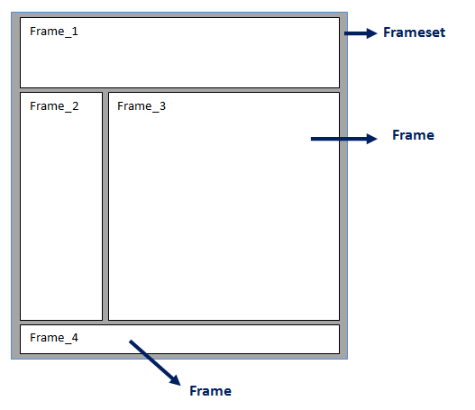
Frameset

Slide 71
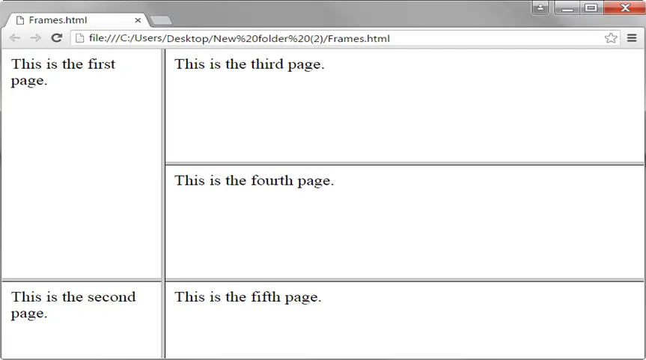

Slide 72
Tag:
<frameset>…….</frameset>
Attributes:
Rows=“pixel|%|*”
Cols =“pixel|%|*”
Border=“pixel”
Bordercolor=“color”
Frameborder=“pixel
<frame>
Attribute
Src=“filename”
Name=“”
Noresize
Scrolling=“yes/no/auto”
Framespacing=“pixel”
Marginheight=“56”
Margin width=“45”
Bordercolor=“color”
Frameborder=“pixel

Slide 73
Example
<frameset rows=“30%,40%,*>
<frame src=“backgr.html”>
<frame src=“fom1.html”>
<frame src=“form1.html”>
</frameset>

Slide 74
Nested frameset
Example code
<frameset cols="50%,30%,20%">
<frame src="a.html“ name=“main”>
<frameset rows="20%,60%,20%">
<frame src="2.html">
<frame src="3.html">
<frame src="4.html">
</frameset>
<frame src="5.html">
</frameset>

Slide 75
File name : a.html
<body>
<a href="form.html" target="main">name</a>
<a href="formr.html" target=“second">name</a>
</body>

Slide 76
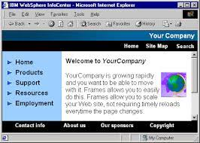
Sample output

Slide 77
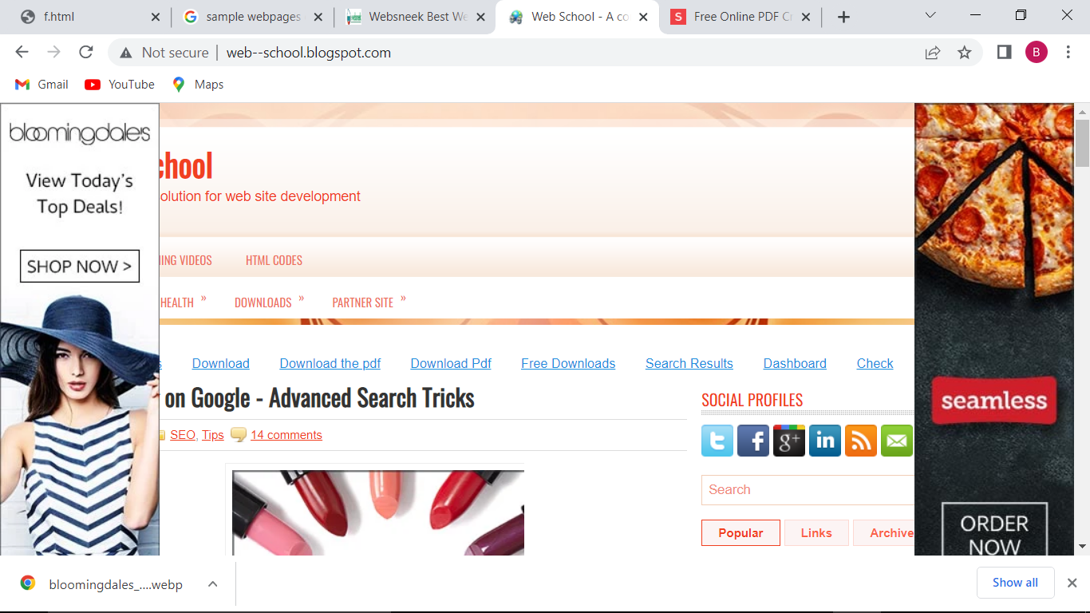

Slide 78
Floating frame : <iframe>
Attributes:
SRC=“url”
Height=“pixel”
Width=“pixel”
Hspace=“pixel”
Vspace=“pixel”
Align=“left/right”
Frameborder= “pixel”

Slide 79
Insert file into iframe
<html>
<body>
<iframe width="500" height="320" src=“formr.html">
</iframe>
</body>
</html>

Slide 80
Embed videos into IFrame
<html>
<head>
<title>Nature</title>
</head>
<body>
<iframe width="500" height="320" src="C:\Users\SYS37\Desktop\natu.mp4">
</iframe>
</body>
</html>

Slide 81
Insert Youtube videos into IFrame
<html>
<body>
<iframe width="500" height="320"
src="https://www.youtube.com/embed/860irbmrb3s"> </iframe>
</body>
</html>

